Slide 1
From Flowcharts to Code
A supplemental lesson for AP CSP

Slide 2
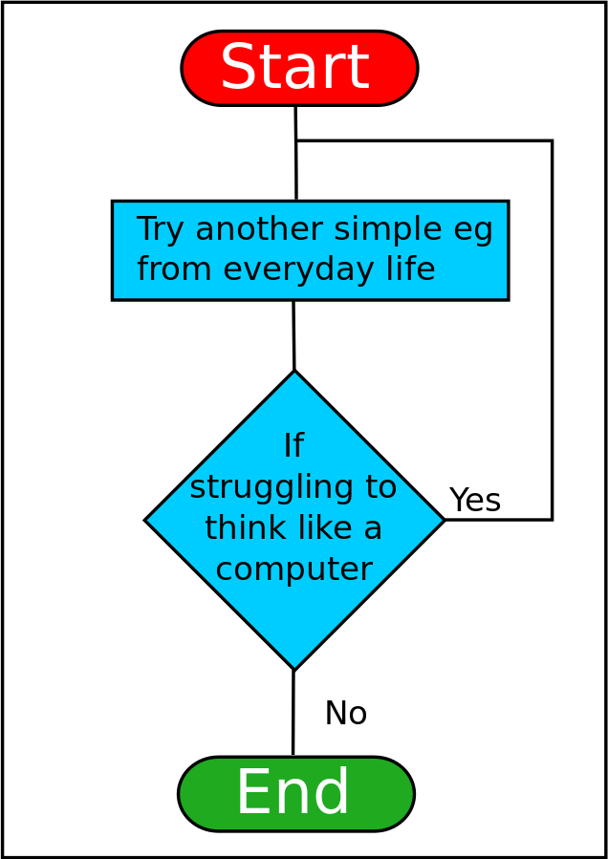
Flowcharts Review
Flowcharts can help you:
Organize your thoughts and ideas
Use shapes to visualize the solution
Track variables
Identify computations
Look for patterns
Source: https://en.wikiversity.org/wiki/File:ThinkLikeComputerFlowchart.svg

Slide 3
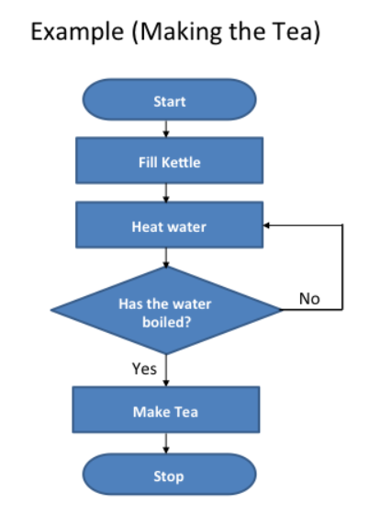
Flowcharts Review
A flowchart visualizes the algorithm, or how to solve the problem.
It is like a graphic organizer.
There are four common shapes used when creating a flowchart:
Source: https://www.teachwithict.com/flowcharts.html#google_vignette

Slide 4
Flowchart Symbols
Review
Use an oval to mark the beginning and end of the program.
start or stop
Use a parallelogram to show input or output. Input could be the button pressed. Output could be text on the console panel, LEDs lit, a sound played or movement.
input or output
flow lines
Use a rectangle to process an action. It could be used to assign a value to a variable, or increment a counter, or get a random number.
action or process
Use lines to connect the shapes. The arrows show the direction of the steps. Some lines should include labels, such as yes or no, to explain what is happening.
Use a diamond to make decisions. This shape will have two or more lines that come from it – one for each outcome. This step might ask a question or provide options. The result could be true or false, yes or no, or choices (red, blue, or green).
decision

Slide 5
Flowcharts to Code Assignment
In an earlier assignment, you created a flowchart from existing code.
In today’s lesson, you will use a flowchart to create Python code.
Source: https://www.teachwithict.com/flowcharts.html#google_vignette

Slide 6
Flowchart and Code review
Practice with Kahoot!
Use your phone or computer.
Go to kahoot.it
Type in the game PIN from your teacher

Slide 7
Flowcharts
Now you will be given a flowchart, and you need to write the Python code that it visualizes.
Show a heart
Give instructions
display.show(pic.HEART)
display.print(“Press a button)
Increment the count
Initialize count
count = count + 1
count = 0
Is count < 5?
Was button A pressed?
if count < 5:
if buttons.was_pressed(BTN_A):

Slide 8
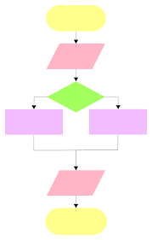
Your Turn!
Create Python code from a flowchart.

Slide 9
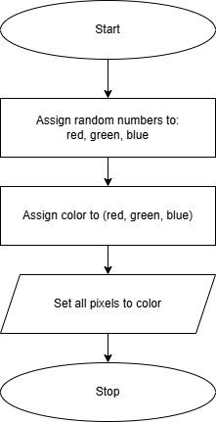
Flowchart #1
This program is sequential.

Slide 10
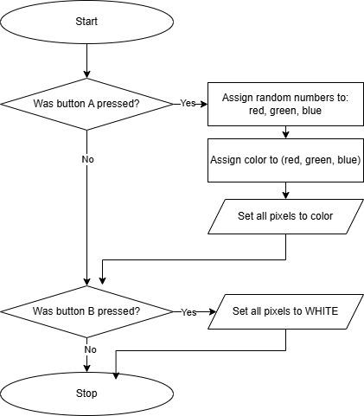
Flowchart #2
This program has selection. You will use 2 if statements.

Slide 11
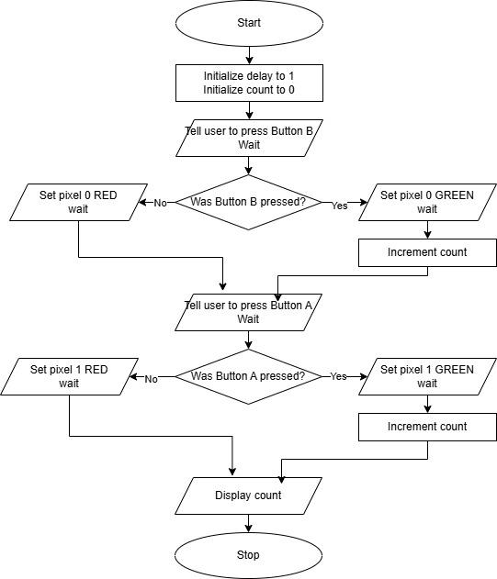
Flowchart #3
This program has selection. You will use 2 if statements.
A “wait” means to use a sleep().

Slide 12
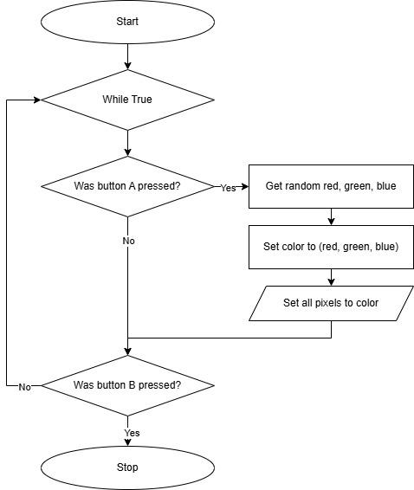
Flowchart #4
This program has iteration (a loop) and selection.
You will use 2 if statements.

Slide 13
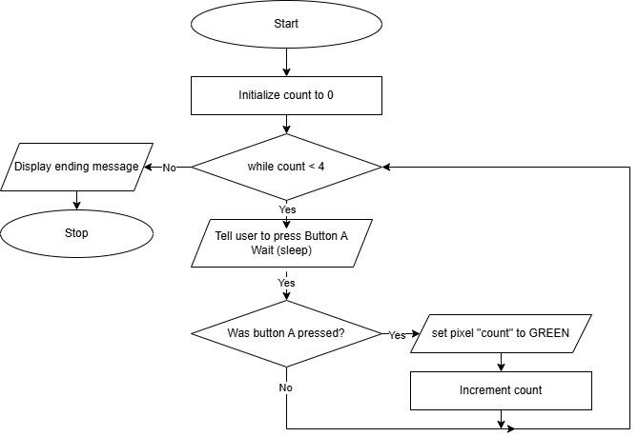
Flowchart #5
This program has iteration (a loop) and selection.
You will use 1 if statement.

Slide 14
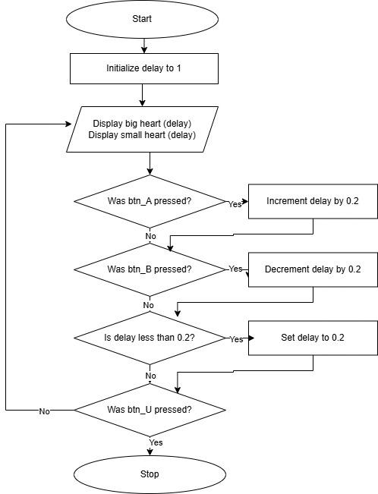
Flowchart #6
This program has iteration (a loop) and selection.
The loop is indicated by the arrows – there is not a specific flowchart symbol for it.

Slide 15
Flowcharts Summary
Definition: An algorithm is a sequence of steps for completing a task.
Definition: A flowchart is a diagram that uses shapes, lines, and arrows to sequence steps.
Definition: A flowchart is a visual representation of the input, output, decisions, and actions that take place within a program.
Source: https://www.teachwithict.com/flowcharts.html#google_vignette

